Slide 1
Discover the famous people
Audio 1: Who is he/she? Miley Cyrus
Audio 2: Who is he/she? Demi Lovato
Audio 3: Who is he/she? David Beckham
Audio 4: Who is he/she? Justin Bieber
Audio 5: Who is he/she? Robert Pattinson
Audio 6: Who is he/she? Adele
Audio 7: Who is he/she? Beyoncé
Audio 8: Who is he/she? Selena Gómez

Slide 2
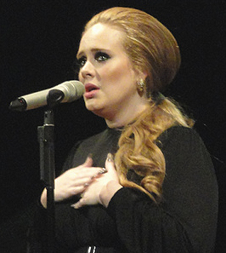
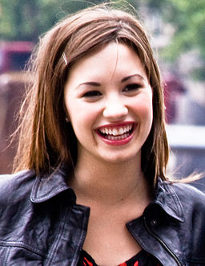
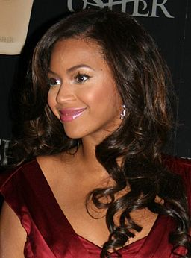
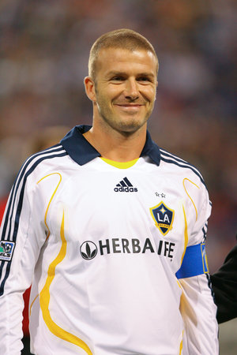
Adele
Demi
Lovato
Beyoncé
David
Beckham
Discover the famous people

Slide 3
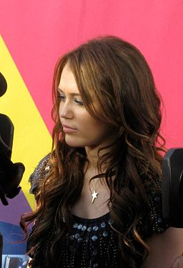
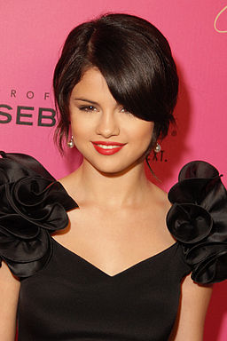
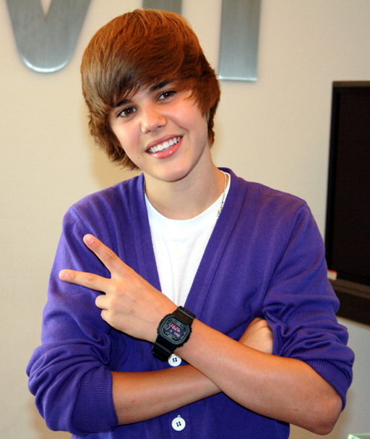
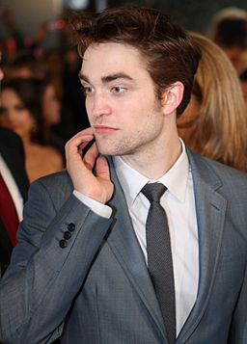
Miley
Cyrus
Selena
Gómez
Justin Bieber
Discover the famous people
Robert
Pattinson

